Slide 1
COMP3028 Software Architecture

Slide 2
Software Architecture
Quality attributes: Performance

Slide 3
Intended Learning Outcomes
By the end of this lesson you will be able to:
apply the design decision categories to performance quality attribute

Slide 4
Performance

Slide 5

Open Question
Points: 10
For the software you designed recently, did you consider any performance requirements? What were they?
Open Question is only supported on Version 2.0 or newer.
Answer

Slide 6
What is Performance?
It is about time
Performance is about time and the software system’s ability to meet timing requirements
When events occur, the system must respond to them in time
Events include interrupts, messages, requests from users or other systems, or clock events marking the passage of time

Slide 7
Performance General Scenario
Portion of Scenario | Possible Values
Source | Internal or external to the system
Stimulus | Arrival of a periodic, sporadic, or stochastic event
Artifact | System or one or more components in the system.
Environment | Operational mode: normal, emergency, peak load, overload.
Response | Process events, change level of service
Response Measure | Latency, deadline, throughput, jitter, miss rate

Slide 8
Performance concrete scenario - example
You are an architect on the Campus Software team and you are designing the system for performance
In the requirements document you have found this requirement:
The system should process the transactions with an average latency of two seconds
Is this description complete, is it clear enough for the architect to make good design decisions?
Which parts are missing?

Slide 9
Poll
2 answer(s) at most
Which parts are missing in the performance concrete scenario example we discussed?
A
Source
B
Stimulus
C
Artifact
The system should process the transactions with an average latency of two seconds
D
Environment
E
Response
F
Response measure
Submit

Slide 10
Sample Concrete Performance Scenario – not complete
The system processes the transactions with an average latency of two seconds.
Stimulus:
The system should process the transactions with an average latency of two seconds

Slide 11
Sample Concrete Performance Scenario – not complete
The system processes the transactions with an average latency of two seconds.
Stimulus: transaction arrivals
The system should process the transactions with an average latency of two seconds

Slide 12
Sample Concrete Performance Scenario – not complete
The system processes the transactions with an average latency of two seconds.
Stimulus: transaction arrivals
Source:
The system should process the transactions with an average latency of two seconds

Slide 13
Sample Concrete Performance Scenario – not complete
The system processes the transactions with an average latency of two seconds.
Stimulus: transaction arrivals
Source: ???
The system should process the transactions with an average latency of two seconds

Slide 14
Sample Concrete Performance Scenario – not complete
The system processes the transactions with an average latency of two seconds.
Stimulus: transaction arrivals
Source: ???
Artifact:
The system should process the transactions with an average latency of two seconds

Slide 15
Sample Concrete Performance Scenario – not complete
The system processes the transactions with an average latency of two seconds.
Stimulus: transaction arrivals
Source: ???
Artifact: the system
The system should process the transactions with an average latency of two seconds

Slide 16
Sample Concrete Performance Scenario – not complete
The system processes the transactions with an average latency of two seconds.
Stimulus: transaction arrivals
Source: ???
Artifact: the system
Response:
The system should process the transactions with an average latency of two seconds

Slide 17
Sample Concrete Performance Scenario - complete
The system processes the transactions with an average latency of two seconds.
Stimulus: transaction arrivals
Source: ???
Artifact: the system
Response: process the transactions
The system should process the transactions with an average latency of two seconds

Slide 18
Sample Concrete Performance Scenario – not complete
The system processes the transactions with an average latency of two seconds.
Stimulus: transaction arrivals
Source: ???
Artifact: the system
Response: process the transactions
Response measure:
The system should process the transactions with an average latency of two seconds

Slide 19
Sample Concrete Performance Scenario – not complete
The system processes the transactions with an average latency of two seconds.
Stimulus: transaction arrivals
Source: ???
Artifact: the system
Response: process the transactions
Response measure: average latency of two seconds
The system should process the transactions with an average latency of two seconds

Slide 20
Sample Concrete Performance Scenario – not complete
The system processes the transactions with an average latency of two seconds.
Stimulus: transaction arrivals
Source: ???
Artifact: the system
Response: process the transactions
Response measure: average latency of two seconds
Environment:
The system should process the transactions with an average latency of two seconds

Slide 21
Sample Concrete Performance Scenario – not complete
The system processes the transactions with an average latency of two seconds.
Stimulus: transaction arrivals
Source: ???
Artifact: the system
Response: process the transactions
Response measure: average latency of two seconds
Environment: ???
The system should process the transactions with an average latency of two seconds

Slide 22
Sample Concrete Performance Scenario – not complete
The system processes the transactions with an average latency of two seconds.
Stimulus: transaction arrivals
Source: ???
Artifact: the system
Response: process the transactions
Response measure: average latency of two seconds
Environment: ???
This scenario is not complete, source and environment parts are missing

Slide 23
Multiple Choice(multiple)
Points: 1
Which parts are missing in the performance concrete scenario example we discussed?
A
Source
B
Stimulus
C
Artifact
The system should process the transactions with an average latency of two seconds
D
Environment
E
Response
F
Response measure
Submit

Slide 24
The scenario we studied is not clear enough for the architect to make good design decisions
How to add the remaining parts?

Slide 25
How to add the remaining parts?
We can use the general scenario to help us look for ideas
Then, clarify with the stakeholders about the details of the requirement

Slide 26
Performance General Scenario
Portion of Scenario | Possible Values
Source | Internal or external to the system
Stimulus | Arrival of a periodic, sporadic, or stochastic event
Artifact | System or one or more components in the system.
Environment | Operational mode: normal, emergency, peak load, overload.
Response | Process events, change level of service
Response Measure | Latency, deadline, throughput, jitter, miss rate

Slide 27
Open Question
Points: 10
You are an architect on the Campus Software team and you are designing the system for performance. In the requirements document you have found this requirement:
The system should process the transactions with an average latency of two seconds.
Rewrite this requirement by making sure all the 6 elements of the quality attribute scenario are included.
Open Question is only supported on Version 2.0 or newer.
Answer

Slide 28
Sample Concrete Performance Scenario - complete
The system processes the transactions with an average latency of two seconds.
Stimulus: transaction arrivals
Source: users
Artifact: the system
Response: process the transactions
Response measure: average latency of two seconds
Environment: under normal operations

Slide 29
Sample Concrete Performance Scenario - complete
Users initiate transactions under normal operations. The system processes the transactions with an average latency of two seconds.
Stimulus: transaction arrivals
Source: users
Artifact: the system
Response: process the transactions
Response measure: average latency of two seconds
Environment: under normal operations

Slide 30
Sample Concrete Performance Scenario
Users initiate transactions under normal operations. The system processes the transactions with an average latency of two seconds.
Stimulus: transaction arrivals
Source: users
Artifact: the system
Response: process the transactions
Response measure: average latency of two seconds
Environment: under normal operations

Slide 31
Performance Modeling
Two basic contributors to the response time
Processing time is the time that the system is working to respond
Blocked time is the time that the system is unable to respond
Blocked time is caused by
Contention for resources
Availability of resources
Dependency on other computations

Slide 32
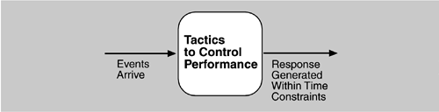
Goal of Performance Tactics
To generate a response to an event arriving the system within some time-based constraint
The event can be single or a stream, and is the trigger to perform computation

Slide 33
First, lets consider an example not related to the computing
You are an owner of the noodle shop.
You hired one cook who is able to cook 100 bowls during lunch time
Your restaurant has 20 seats
On the first day, there were over 200 people lining up for your noodles
You want to improve the performance of your noodle shop to make sure you serve as many customers as possible during the day.
Give examples of the tactics that you could use

Slide 34
Two Tactic Categories
Control resource demand
To produce smaller demand on the resources
Operate on the demand side
Manage resources
To make the resources at hand work more effectively in handling the demands
Operate on the response side

Slide 35
Resources
Hardware resources, e.g., CPU, data stores, network bandwidth, and memory
Software resources, e.g., buffers, or critical sections

Slide 36
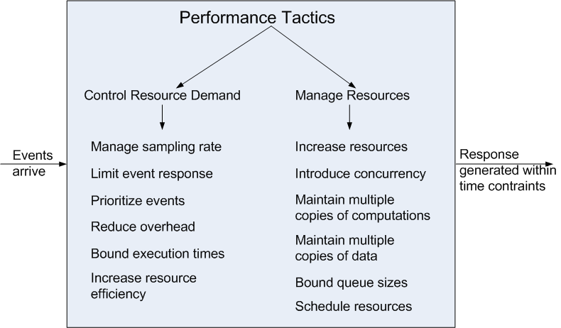
Performance Tactics

Slide 37
Control Resource Demand
Manage Sampling Rate: to reduce the sampling frequency at which a stream of data is captured
Prioritize Events: to impose a priority scheme that ranks events according to the importance
Ignore low-priority events when resources are not enough

Slide 38
Control Resource Demand
Reduce Overhead: The use of intermediaries increases the resources consumed in processing an event stream; removing them improves latency.

Slide 39
Open Question
Points: 10
We just said that the use of intermediaries increases the resources consumed in processing an event stream; removing them improves latency, therefore if we have high performance requirements on the system, we should not introduce intermediaries in the system architecture.
In what cases you may want to make a different decision – introduce intermediaries even though the system has high performance requirements?
Open Question is only supported on Version 2.0 or newer.
Answer

Slide 40
Control Resource Demand
Reduce Overhead: The use of intermediaries increases the resources consumed in processing an event stream; removing them improves latency.
Tradeoff between the modifiability and performance
Bound Execution Times: Place a limit on how much execution time is used to respond to an event.
In algorithm design, limiting the number of iterations is a method for bounding exec. time
Trade-off between the performance and accuracy

Slide 41
Control Resource Demand
Increase Resource Efficiency: Improving the algorithms used in critical areas will decrease latency.
To reduce the complexity of the algorithm

